Slide 1
Getting good work from AI assistants: prompting for leaders and teams
How do my staff get reliable work from these tools?
Leading with AI | Session 7 of the 15 (Sessions 0 to 14)
KLAi Professional Learning | Jotham Martin Wambi
Notes:
Welcome back. In Session 6 you chose a route for each use: rent, host or build on a partner. Today we take the tool you chose and ask the question every manager asks a month after the licences arrive: how do my staff get reliable work from these tools?
We start with a trial of 20,000 civil servants, build a good brief one part at a time from recorded runs, meet reasoning models and the jagged frontier, tour six industries, and test a brief on one sum run ten times. Then you write a tested brief for one of your own team’s tasks.

Slide 2



Today in one view: what you will leave with
By the end of today you will have
Write a brief with the five parts (role, context, examples, format, constraints) and say what each one changes
Test a brief on a small set of real tasks and count the right answers before a team relies on it
Name where assistants help and where they mislead your people, and add one team task with its tested brief to your portfolio
Notes:
That question gives you three things to leave with. You will write a brief with five parts, role, context, examples, format and constraints, and know what each one changes, because you will see each change recorded. You will test a brief on a small set of real tasks and count the right answers before anyone relies on it.
And you will know where assistants help your people and where they mislead them, with one team task and its tested brief in your portfolio.

Slide 3
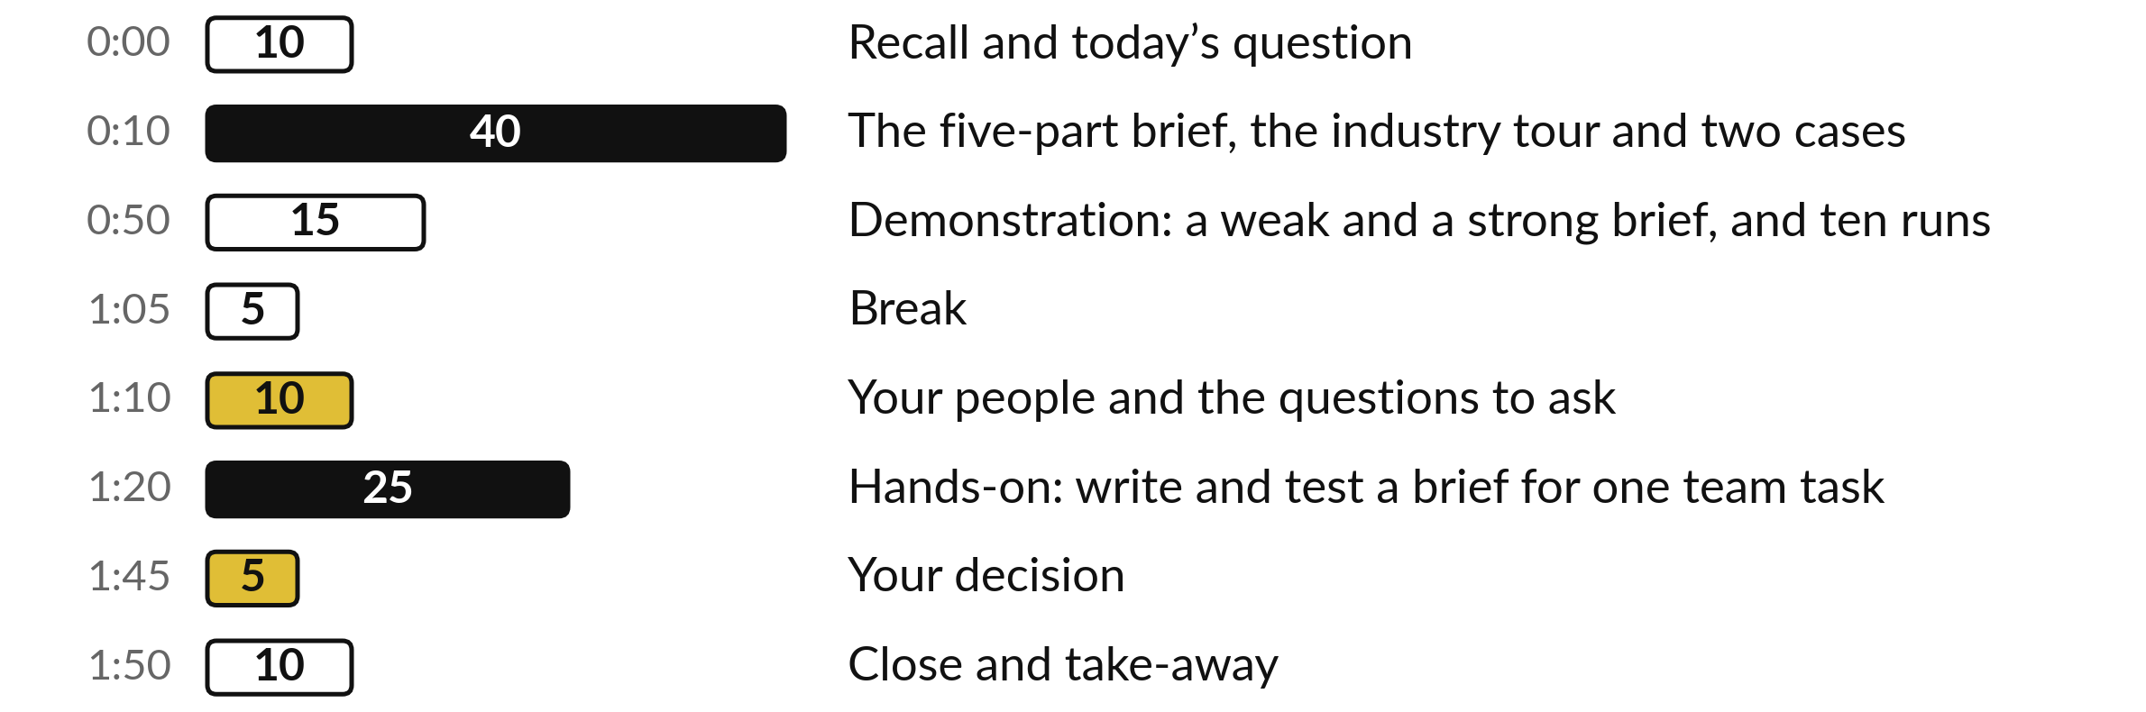
Your two hours: the five-part brief, the evidence,
a recorded test, then your own team’s brief
I show recorded runs, before and after. You write and plan the test of a brief for your own team.
Notes:
Here is how the two hours run. Ten minutes to recall Session 6 and meet today’s question. Forty minutes on the brief, one part at a time with recorded runs, then reasoning models, the jagged frontier, six industries and two cases. Fifteen minutes of demonstration: a weak and a strong brief on the same figures, and one sum run ten times.
A five-minute break. Ten minutes on your people. Then twenty-five minutes on your own team’s brief, five on your decision, and ten to close.

Slide 4

Three questions from last time
1. In Session 6, what are the three routes to an AI model?
2. Which four questions decide the route?
3. What did the recorded test of two assistants show about testing?
Answer aloud first. Then we check together.
Notes:
Three quick questions from Session 6. Answer aloud first, and then we check together. It is a warm-up to bring last time back.
Question one. In Session 6, what are the three routes to an AI model? Take a moment.
A good answer is this. Rent a hosted assistant, host an open model, or build on a partner’s platform.
Question two. Which four questions decide the route? Say it to yourself first.
A good answer is this. Where the data goes and what Uganda’s law says, the cost of each use, lock-in, and whether the vendor will survive.
Question three. What did the recorded test of two assistants show about testing? Think about your own work as you answer.
A good answer is this. One real task, an answer key and five checks, counted, tell you more about fit than a benchmark score. One task still proves nothing general.
If an answer was missing, last session’s take-away sheet or workbook page has it. Now to today.

Slide 5
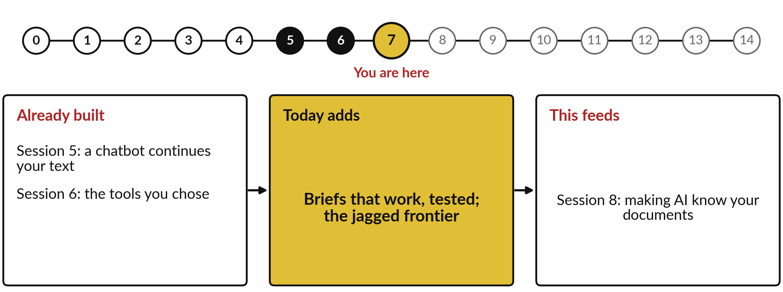
How today connects: what we
already have and what it feeds
Each session is built on the ones before it.
Notes:
So where does today sit in the story? The dots along the top are the fifteen sessions, from the map at Session 0 to your plan at Session 14, and the gold one is today.
We already hold a chatbot continues your text from Session 5 and the tools you chose from Session 6. Nothing today starts from zero.
What today adds is this: briefs that work, tested; the jagged frontier.
And it feeds straight into what comes next. Session 8: making AI know your documents. Keep that chain in mind, because each idea you learn today is a step on it.

Slide 6




Words we use today
Word | What it means
Prompt | Everything you give an assistant: the request and what it needs to do it well. Think of it as a brief.
Few-shot examples | One or two finished examples pasted into the prompt, so the assistant copies their pattern.
Constraints | The limits a reply must keep: what it must not do, and what to say when it is unsure.
Reasoning model | A model that writes out its working before it answers: slower, often better on many-step work.
Jagged frontier | The uneven edge of what AI does well: excellent at some tasks, worse than staff at others that look similar.
Notes:
Five words for today. I give the plain meaning of each, and we use every one of them before the end of the session.
Prompt. Everything you give an assistant: the request and what it needs to do it well. Think of it as a brief.
Few-shot examples. One or two finished examples pasted into the prompt, so the assistant copies their pattern.
Constraints. The limits a reply must keep: what it must not do, and what to say when it is unsure.
Reasoning model. A model that writes out its working before it answers: slower, often better on many-step work.
Jagged frontier. The uneven edge of what AI does well: excellent at some tasks, worse than staff at others that look similar.
Keep those words close. The first idea uses them straight away, so let us begin.

Slide 7
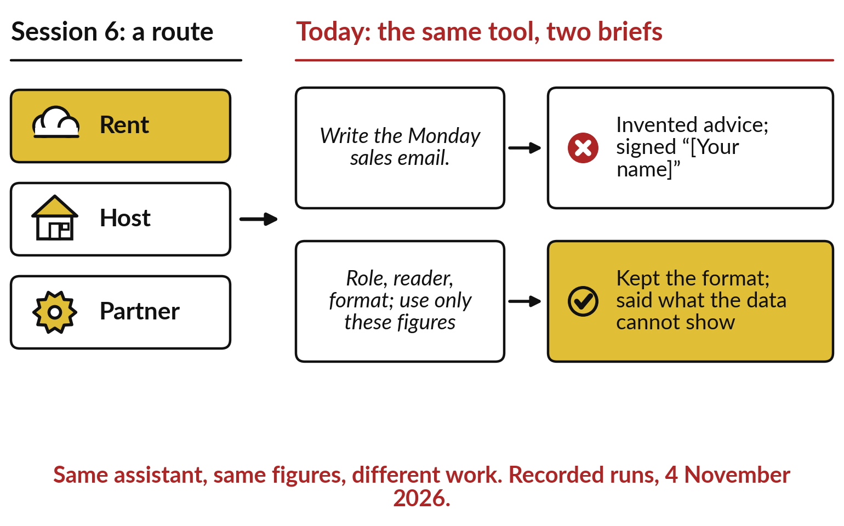
From Session 6 to today: you chose
a tool; now get good work from it
The same assistant gives different work to a weak brief and a strong one.
Session 5: it continues your text with likely words.
So every word of your brief changes the reply.
Notes:
Those five words are all about one habit: briefing well. In Session 6 you chose a route and a tool, on the left. Choosing is half the job. On the right is the other half. The same assistant was given the same sales figures twice. The weak brief said only, write the Monday sales email, and the reply added advice nobody asked for and was signed, your name, in brackets.
The strong brief named the role, the reader, the format, and said use only these figures. That reply kept the format and said what the data could not show. Why does the wording matter so much?
Session 5 told us: the assistant continues your text with likely words, so every word you add changes what comes next. How much is good work worth?

Slide 8
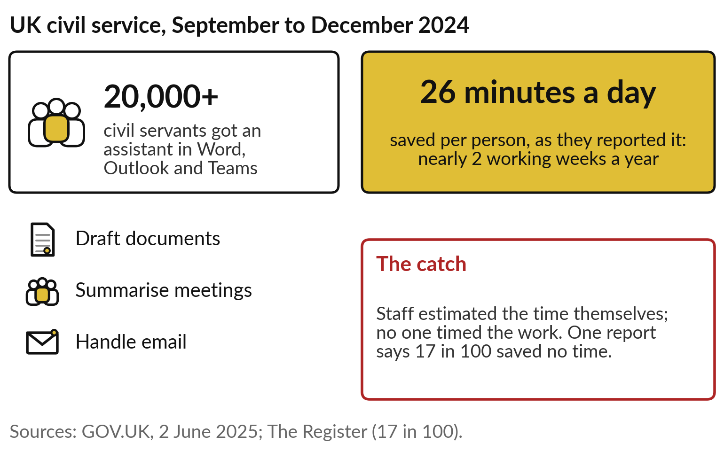
UK, 2024: 20,000 civil servants said an
AI assistant saved them 26 minutes a day
Today’s question: how do my staff get reliable work from these tools?
A large trial, with a gain staff felt.
Self-reported, and uneven between people.
Notes:
A large trial gives one answer. From September to December 2024 the UK government gave more than 20,000 civil servants an AI assistant inside Word, Outlook and Teams. They used it to draft documents, summarise meetings and handle email. On average they reported saving 26 minutes a day, nearly two working weeks a year each.
The catch: staff estimated that time themselves, and no one timed the work. One report of the same survey says 17 in 100 reported no time saved. So the gain is real for many and uneven between people. What separates the people who get good work from those who do not?
Much of it is how they brief the tool. So, how do your staff get reliable work from these tools?

Slide 9
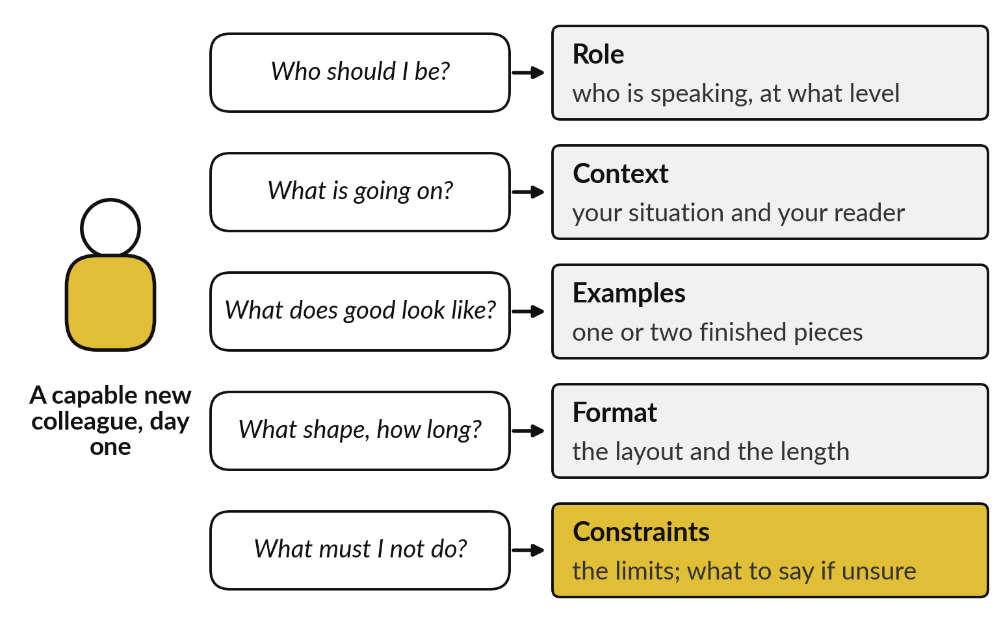
A prompt is a brief to a capable new colleague
who knows nothing about your organisation
Answer the five questions a newcomer would ask, before they have to guess.
Each part removes one guess.
The next five slides show each part, recorded.
Notes:
Start with a picture you know. A capable new colleague joins on Monday. They are quick and well read, and they know nothing about your organisation. Hand them a one-line request and they must guess five things. Who should I be: the role. What is going on: the context.
What does good look like: examples. What shape and how long: the format. What must I not do: the constraints. A prompt, everything you type to an assistant, works the same way, and a good one answers those five questions before the assistant has to guess. The analogy has a limit: the assistant does not ask; it guesses silently and sounds sure.
Let me show you each part with a recorded run, before and after.

Slide 10
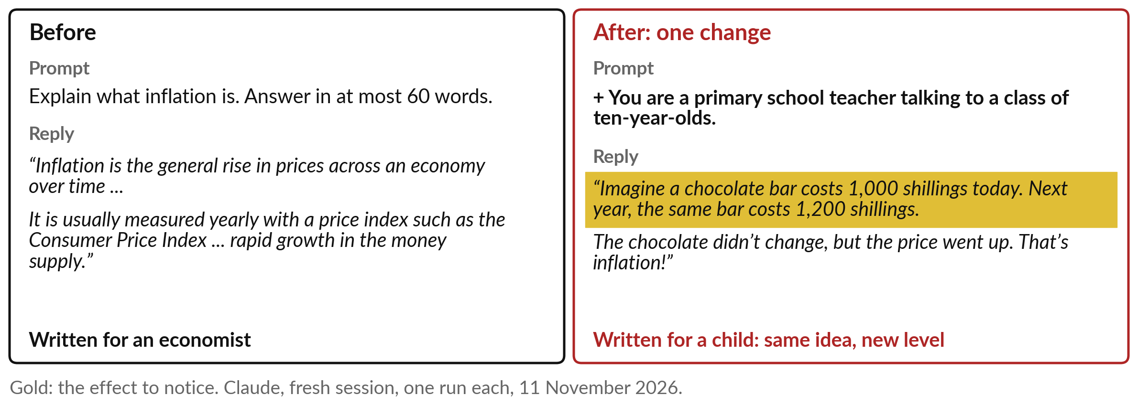
Role: say who the assistant should
be, and it chooses the right level
A role adds no facts. It changes who the reply is written for.
Notes:
The first part is the role. On the left I asked a fresh assistant to explain inflation in at most 60 words. The answer was right, and written for an economist: a price index, the money supply. On the right the only change is one sentence: you are a primary school teacher talking to a class of ten-year-olds.
The reply became a chocolate bar that costs 1,000 shillings today and 1,200 next year. Same idea, a different level. A role adds no facts. It shifts which words are likely, because text written by teachers for children continues differently from text written by economists. Each pair here is one recorded run, so it shows the effect and proves no rate. Next, your situation.

Slide 11
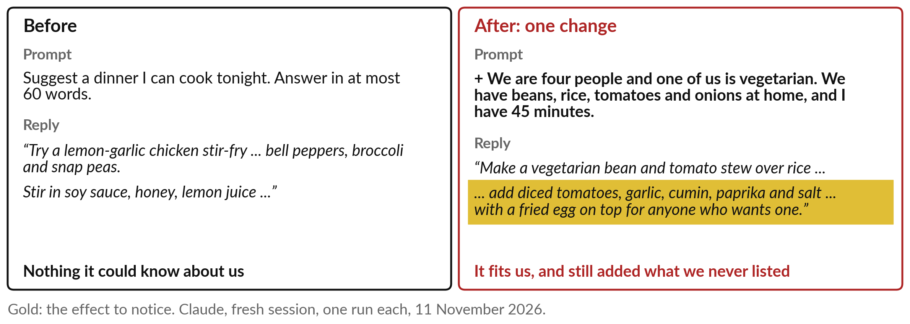
Context: say what your situation
is, and the answer fits your case
Context makes the answer fit. It does not stop the assistant adding things.
Notes:
The second part is the context. Asked only for a dinner I can cook tonight, the assistant suggested a lemon-garlic chicken stir-fry with peppers, broccoli and snap peas. A fine dish, and it could not know that one of us is vegetarian or what is in the kitchen.
On the right I added four people, one vegetarian, beans, rice, tomatoes and onions at home, and 45 minutes. Now it suggested a bean and tomato stew over rice. Look at the gold, though. It still added garlic, cumin, paprika and a fried egg, none of which I listed.
Context makes the answer fit your case. Stopping the additions is another part’s job, which we reach in two slides. First, examples.

Slide 12
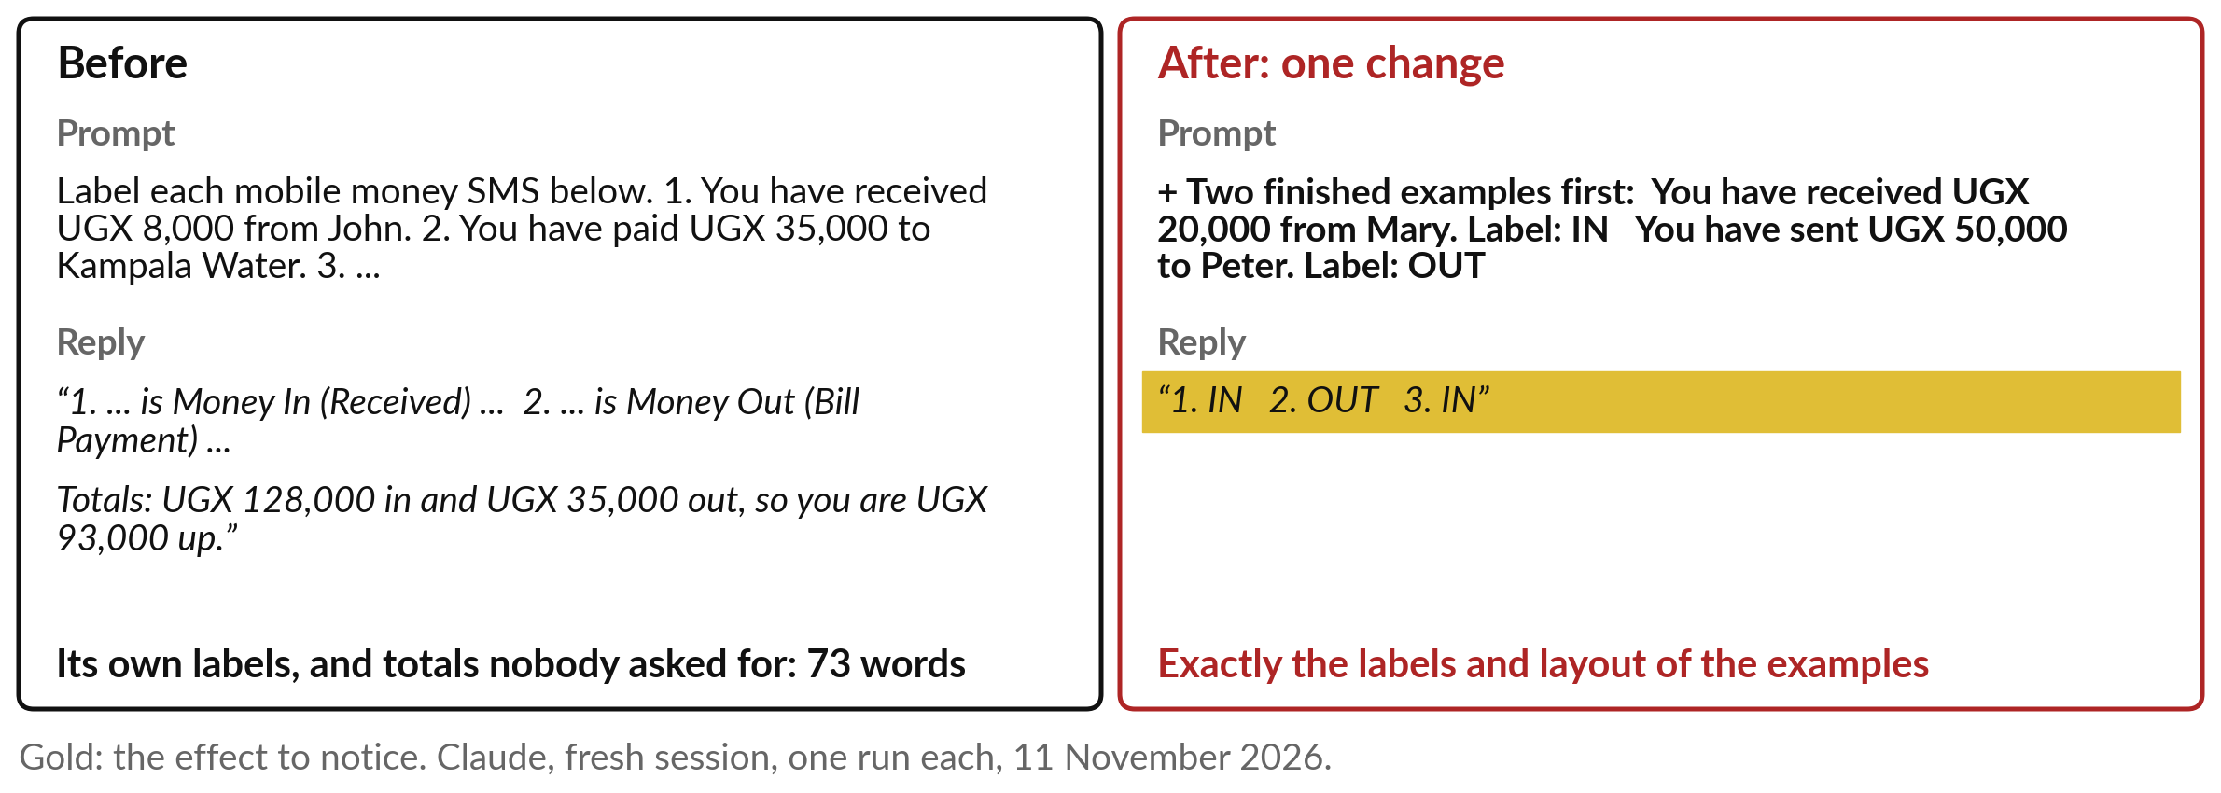
Examples: show one or two finished
cases, and it copies the labels and layout
The industry calls these few-shot examples.
Notes:
The third part is examples. I asked for labels on three mobile money messages with no examples. The answers were right, in the assistant’s own words: money in, received; money out, bill payment; plus totals nobody asked for, 73 words in all. On the right I first pasted two finished examples: you have received 20,000 shillings from Mary, label IN; you have sent 50,000 to Peter, label OUT.
The reply was one word per line: IN, OUT, IN. The examples are part of the text it continues, so the likeliest reply copies their pattern. The industry calls these few-shot examples. Google’s guide advises varied examples in one layout. When your team needs the same labels every time, examples are the quickest fix. Next, the shape of the answer.

Slide 13
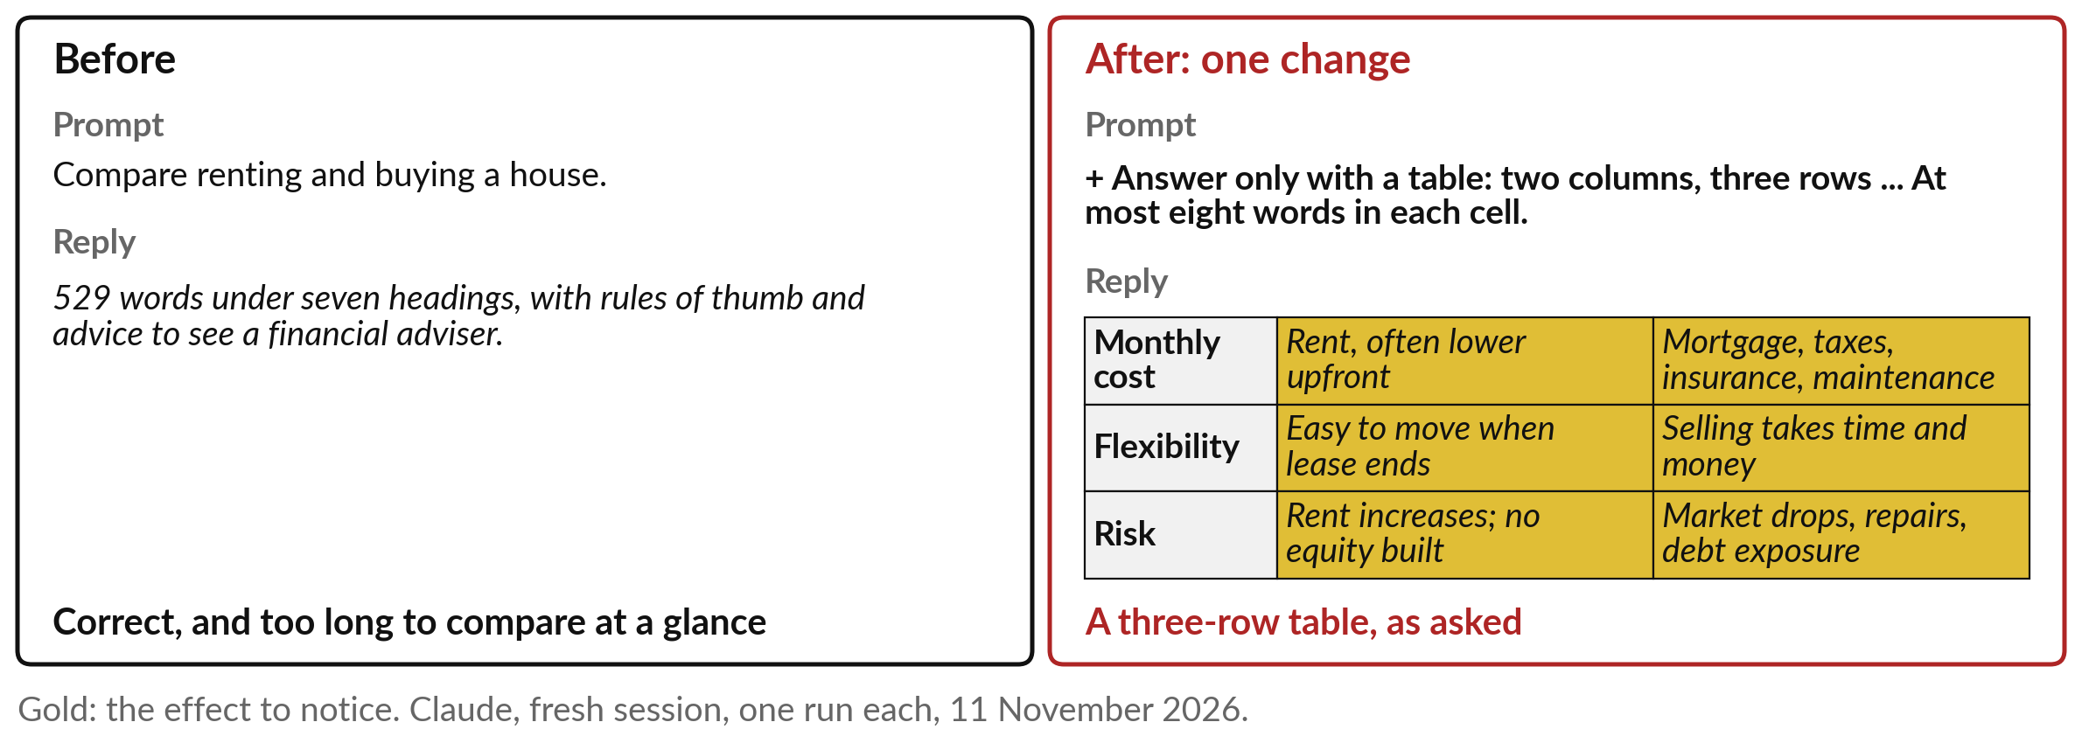
Format: say the shape and the length,
and you can read the answer at a glance
A stated format also makes a missing row easy to spot.
Notes:
The fourth part is the format. Asked to compare renting and buying a house, the assistant wrote 529 words under seven headings, with rules of thumb and advice to see a financial adviser. Nothing in it was wrong, but you cannot compare two options at a glance in 529 words.
On the right, the only change is the format: answer only with a table, two columns, three rows, at most eight words a cell. The reply was exactly that table. A stated format does two jobs. It saves your reader time, and it makes the answer easy to check, because a missing row shows at once.
Four guesses are gone. One remains: what it must not do. Remember the dinner that came with cumin and an egg.

Slide 14
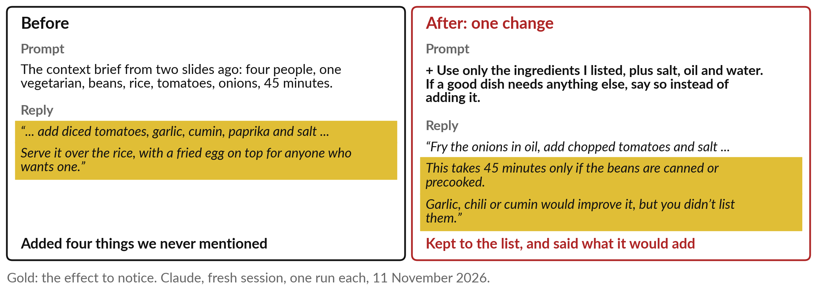
Constraints: say what is off limits,
and what to do when unsure
Constraints add no knowledge. They set the edges, and invite it to say what it does not know.
Notes:
The fifth part is the constraints: the limits a reply must keep. On the left is the context run from two slides ago, which fitted our evening and still added garlic, cumin, paprika and an egg. On the right I added two sentences: use only the ingredients I listed, plus salt, oil and water, and if a good dish needs anything else, say so instead of adding it.
The reply kept to the list. It named garlic, chili or cumin as improvements we had not listed, and it warned that 45 minutes holds only if the beans are canned or precooked. That last line is the most valuable kind: the assistant telling you what it could not promise.
In business, this is the part that stops invented prices, policies and promises. So, is a good brief enough?

Slide 15
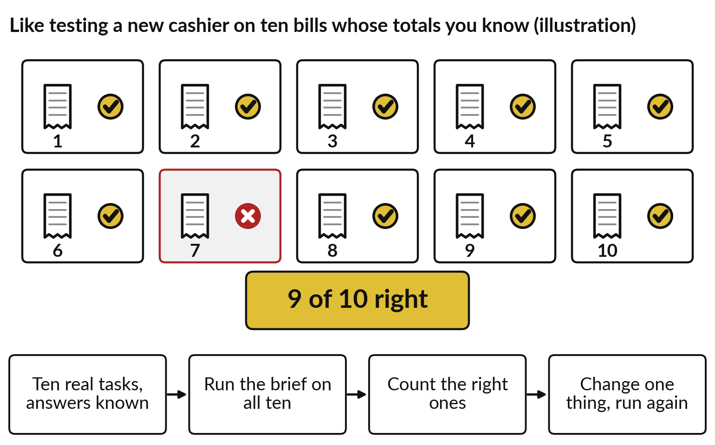
Test a brief on ten real tasks with known
answers, and count, before a team relies on it
One good reply can be luck. Ten, counted, is evidence.
Use past tasks whose right answer you know.
Change one thing at a time, then count again.
Keep the count with the brief.
Notes:
Not quite, because one good reply can be luck: the assistant picks likely words, and the next run can differ. So test a brief the way you would test a new cashier. Give ten bills whose totals you already know. The cashier gets nine right; bill seven is wrong.
Nine of ten. For a brief, take ten real past tasks whose right answer you know, run the brief on all ten, and count the right ones. Then change one thing, run again and count again. In Session 3 we judged a vendor’s accuracy claim; this is the same habit on your own work, at the scale of ten.
Small sets swing, so treat nine of ten as encouraging and short of proof. Keep the count with the brief. Some assistants now do part of the checking themselves.

Slide 16
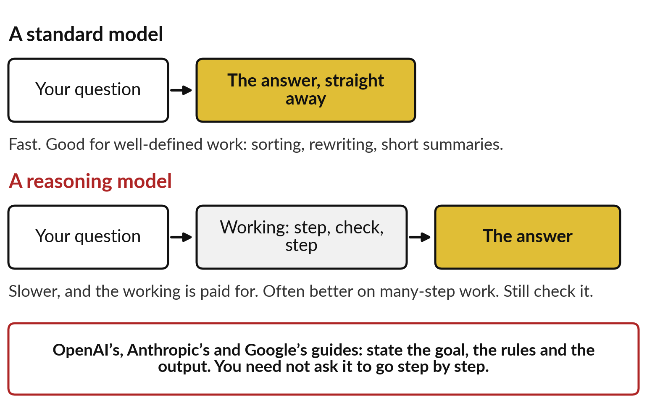
Reasoning models write out their working before
answering: slower, often better on many-step work
For a many-step task, a reasoning model may do better. You still check.
Standard: fast, for well-defined work.
Reasoning: slower, the working is paid for.
Frame the goal, the rules and the output.
Notes:
These are reasoning models. A standard model starts its answer straight away. A reasoning model, or an assistant with its thinking switched on, first writes out working, steps and checks, and then the answer. Depending on the product you see that working, a summary of it, or nothing.
What should a leader expect?
It is slower, and the working is usually paid for as part of the use. It can do better on problems with many steps, such as a payroll sum or a plan with tangled rules, and it can still be wrong. The guides from OpenAI, Anthropic and Google agree on how to brief one: state the goal, the rules and the output, and you need not ask it to go step by step.
But which tasks suit an assistant at all?

Slide 17
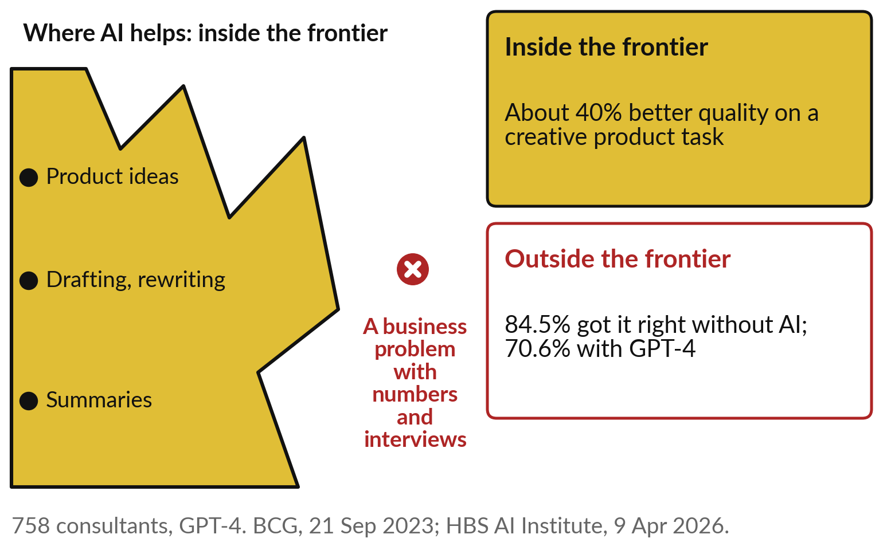
The jagged frontier: excellent at some tasks,
worse than your staff at others that look similar
Inside the frontier AI lifts people. Outside it, people who trust it do worse.
The edge is uneven and hard to see.
Test each task; do not assume.
Notes:
A large experiment answered that. In 2023, 758 consultants at Boston Consulting Group did realistic tasks with or without GPT-4, in a study with Harvard and other universities. On a creative product task, inside what the researchers called the frontier, the group with AI did about 40 per cent better, BCG reported.
Then came a business problem that needed numbers and interviews, chosen to sit outside the frontier. Without AI, 84.5 per cent got it right; with GPT-4, 70.6 per cent. People trusted a fluent answer on a task it could not do. The frontier is jagged: two tasks that look alike can sit on opposite sides, and the edge moves as models change.
That is why you test each task. So where do assistants tend to help?

Slide 18
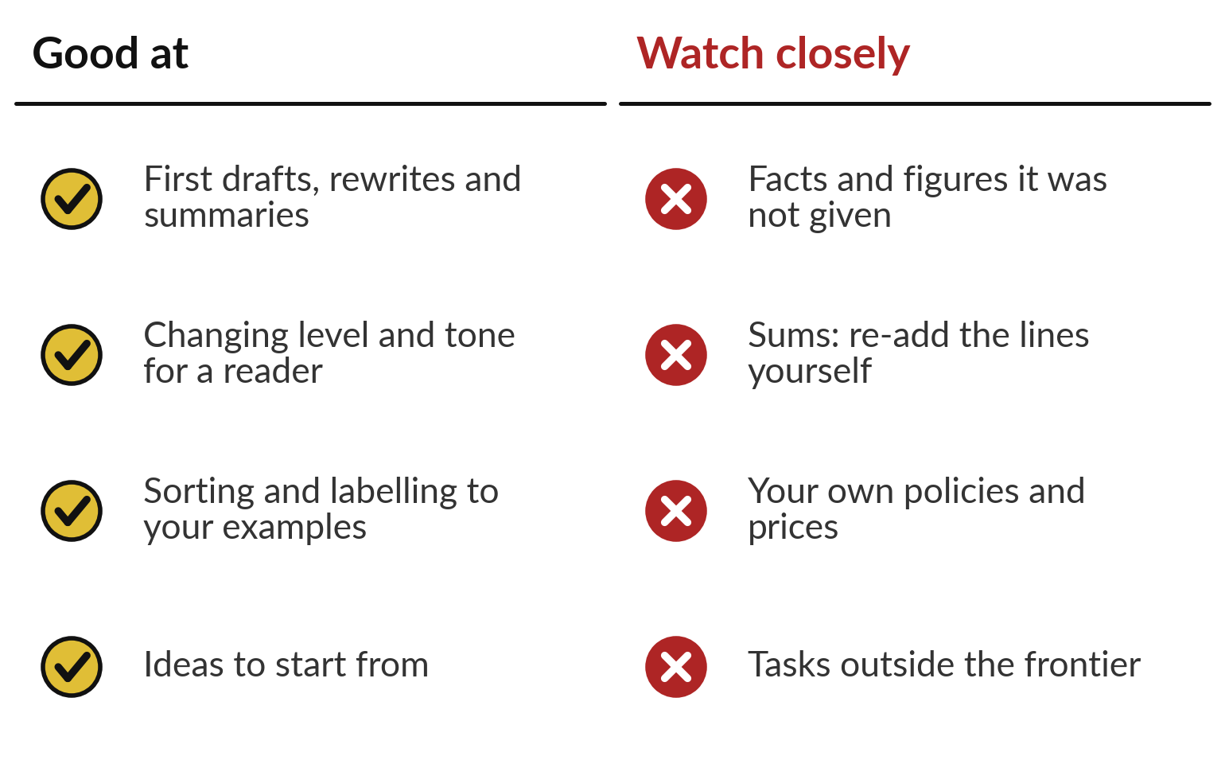
Assistants are good at drafts and rewriting;
watch facts, sums and your own policies
Use them where a person can check the result quickly.
Strong: drafts, level and tone, labels, ideas.
Weak: facts not given, sums, your own rules.
Notes:
Put together, the runs and the experiment give a working rule. Assistants are good at first drafts, rewrites and summaries, at changing the level and tone for a reader, at sorting and labelling to your examples, and at ideas to start from. Watch them closely on facts and figures you did not give them, on sums, where you re-add the lines yourself, on your own policies and prices, which they cannot know unless you supply them, and on tasks outside the frontier.
The test is simple: use them where a person can check the result quickly, and brief them with the five parts. Session 8 shows how to give an assistant your own documents. Now, how are organisations in your industries using them?

Slide 19
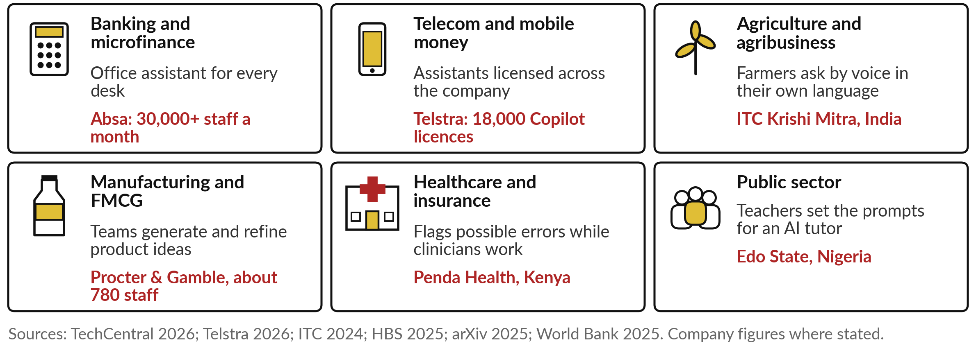
Assistants at work in six industries,
with one named example in each
Two of them follow as stories: Procter & Gamble and Absa.
Notes:
Here are assistants at work in six industries. In banking, more than 30,000 Absa staff use an office assistant every month. In telecom, Telstra in Australia holds 18,000 Copilot licences, with more than 8 in 10 used weekly. In agribusiness, ITC in India lets farmers ask a chatbot by voice in their own language.
In FMCG, about 780 Procter & Gamble staff tested AI on product ideas. In health, Penda Health in Nairobi runs a tool that flags possible errors while clinicians see patients, and the clinician decides. And in the public sector, Edo State in Nigeria ran an AI English tutor where teachers set the prompts.
Find your own industry’s tile. Two stories follow, starting with Procter & Gamble.

Slide 20
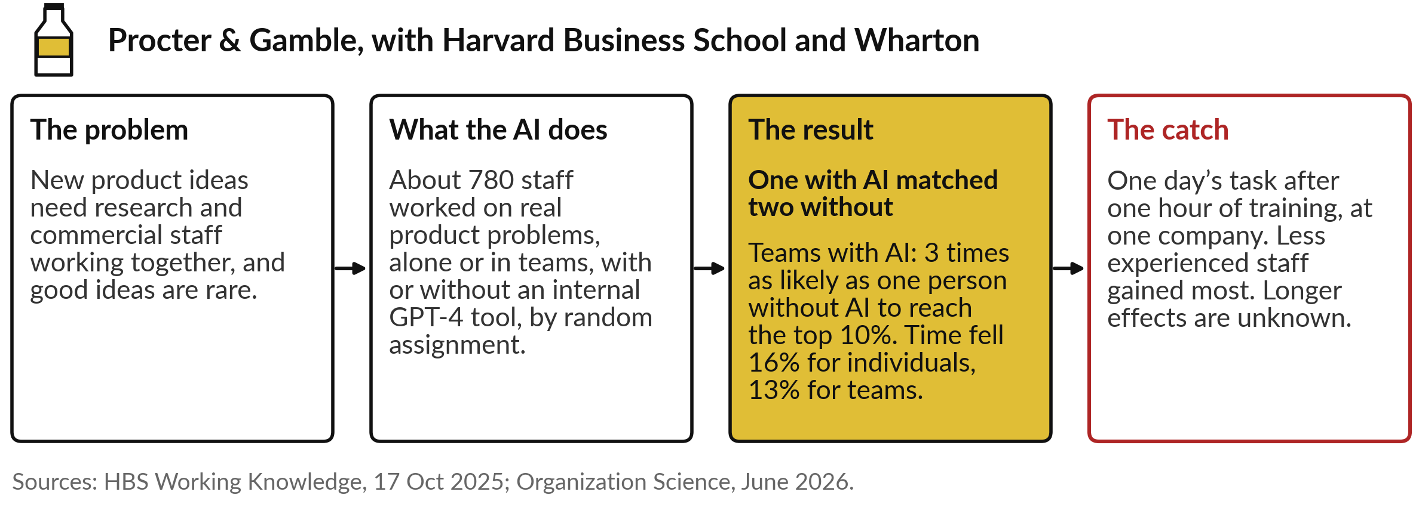
Procter & Gamble: one person with AI
matched a two-person team without it
A randomised experiment: the strongest kind of evidence in this course.
Notes:
The first story is a randomised experiment, the strongest kind of evidence. New product ideas at Procter & Gamble need research and commercial staff working together, and good ideas are rare. In 2024 about 780 staff worked on real product problems in baby care, grooming and oral care.
By random assignment, some worked alone and some in pairs, with or without an internal GPT-4 tool. One person with AI matched the quality of a two-person team without it. Teams with AI were three times as likely as one person without AI to reach the top 10 per cent of ideas, and time fell 16 per cent for individuals and 13 per cent for teams.
Less experienced staff gained most. The catch: it was one day’s task, after one hour of training, at one company.

Slide 21
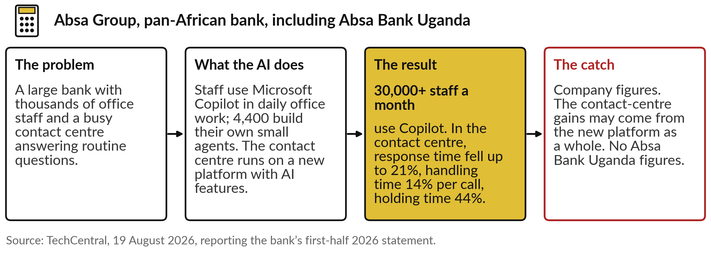
Absa: 30,000 staff use an office assistant
every month, and the contact centre is faster
Scale, and a gain you cannot yet credit to AI alone.
Notes:
The second story is a bank close to home. Absa, which operates in Uganda and which you met in Session 6 spreading its AI across several vendors, says more than 30,000 of its staff use Microsoft Copilot every month in their daily office work, and 4,400 with advanced licences build their own small agents.
Its contact centre moved to a new platform with AI features, and a chatbot answers routine questions. Absa reports that response times fell by up to 21 per cent, handling time by 14 per cent per call, and holding time by 44 per cent. The catch: these are company figures from August 2026.
And the gains may come from the new platform as a whole, so you cannot credit them to AI alone. No figures were published for Absa Bank Uganda. Now let us watch a brief at work on business figures.

Slide 22
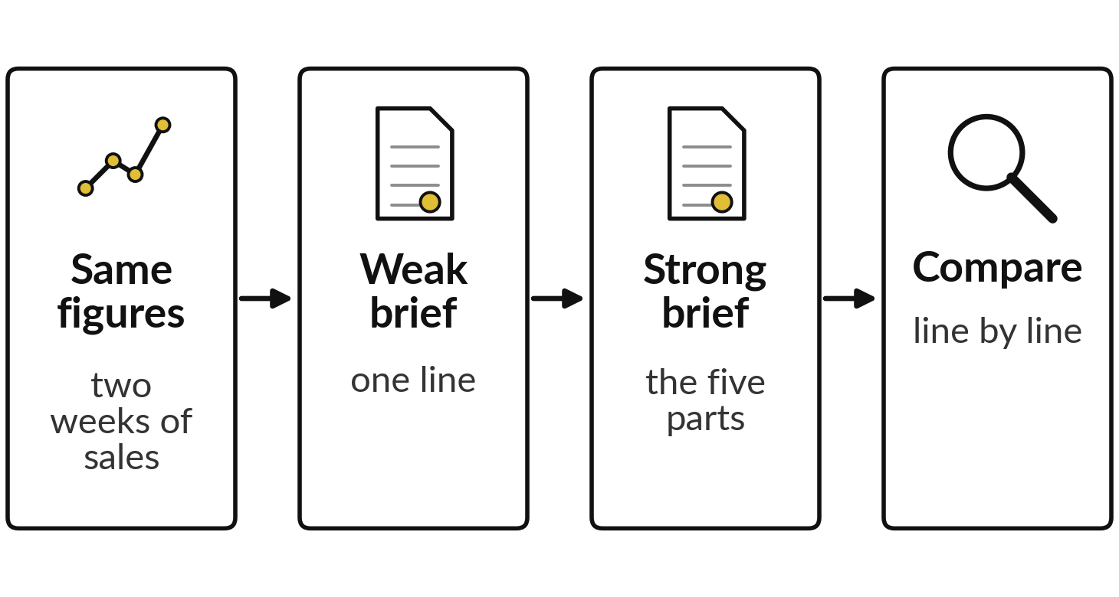
Demonstration: a weak and a strong brief for
the Monday sales email, on the same figures
I will show
Watch for
Whether the figures are right
Anything nobody asked for
What it says the data cannot explain
Notes:
You have seen each part alone on everyday tasks. Now the parts together on a business task. Each Monday, Nile Valley Foods, our fictional distributor of maize flour, sugar and cooking oil, sends its Sales Director a short email with last week’s sales. Two fresh assistant sessions got exactly the same two weeks of figures.
The weak brief said only, write the Monday sales email. The strong brief named the role and the reader, set the format, and added constraints: use only these figures, and say so if something cannot be explained. These are recorded runs from 4 November 2026, one run each.
Watch three things: whether the figures are right, anything nobody asked for, and what each says the data cannot explain.

Slide 23
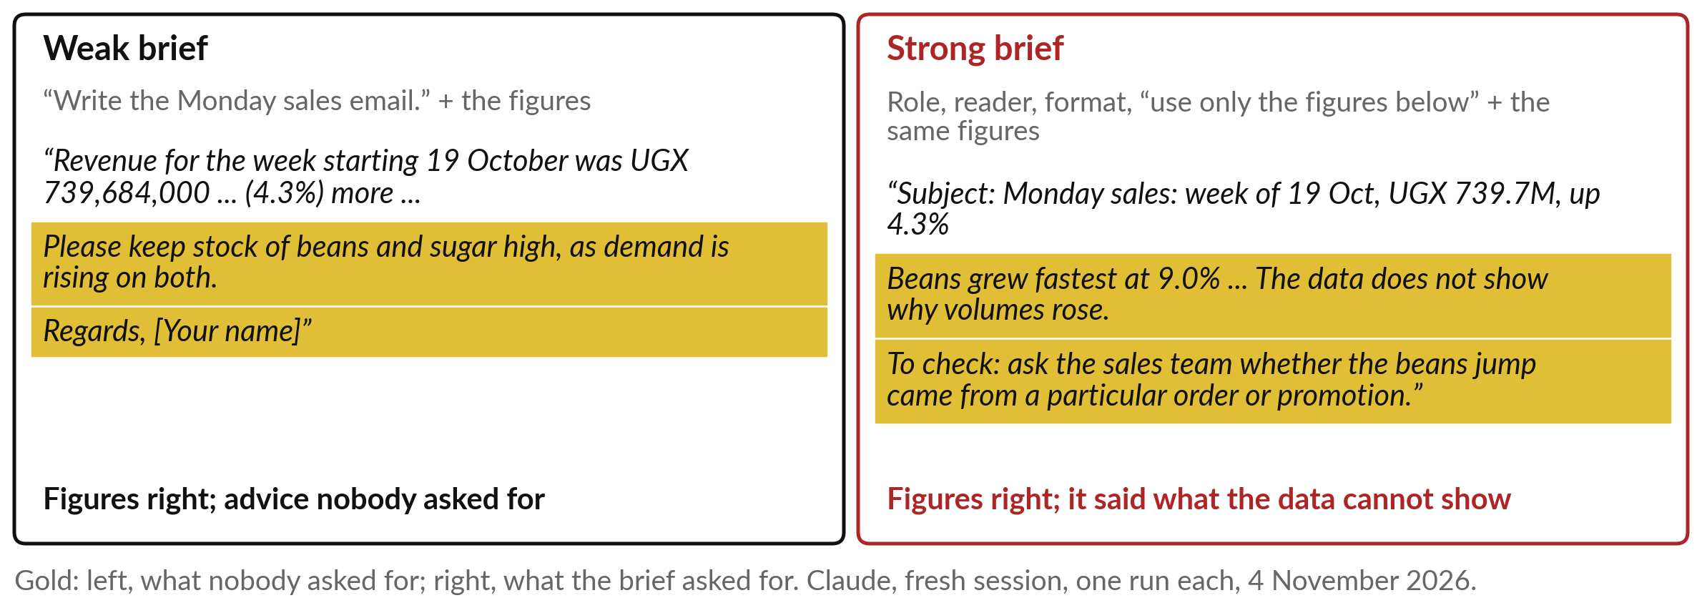
Both got the figures right; the weak brief invented
advice, the strong one said what the data cannot show
The figures were right both times. The difference was what each reply added.
Notes:
What did you see?
Both replies got every figure right: revenue of UGX 739,684,000, up 4.3 per cent, and beans the fastest grower. The difference is what each added. The weak reply told the director to keep stock of beans and sugar high, as demand is rising. Nobody asked for that, and two weeks of figures cannot show a trend.
It also signed off with your name in square brackets, for someone to fill in. The strong reply followed the format, said plainly that the data does not show why volumes rose, and gave one thing to check: whether the beans jump came from one order or a promotion.
A director can act on that safely. So what exactly made the strong brief strong?

Slide 24
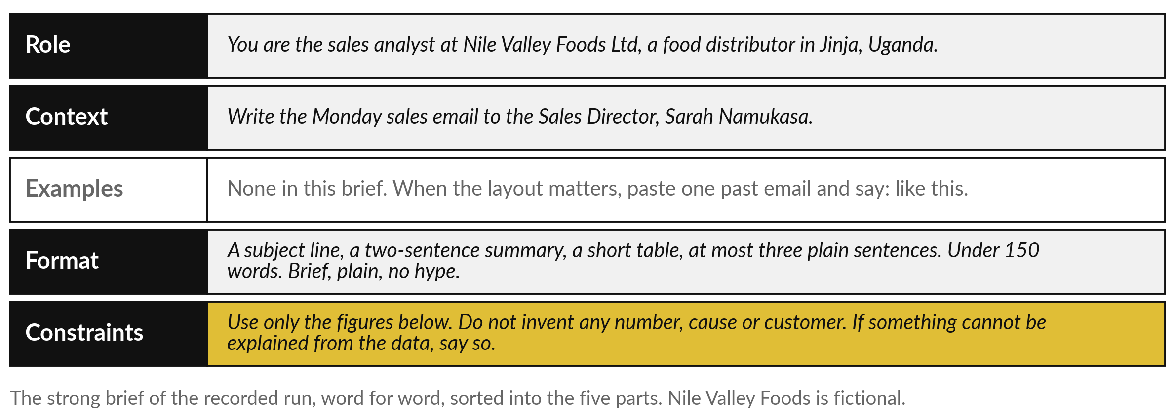
The strong brief taken apart: four of the
five parts, and where an example would go
The constraints did the most work: use only these figures.
Notes:
Here it is, word for word, sorted into the five parts. The role: you are the sales analyst at Nile Valley Foods. The context: the email goes to the Sales Director, so the reader is known. The examples are missing; when the layout really matters, paste one past email and say, like this.
The format: a subject line, a two-sentence summary, a short table and at most three plain sentences, under 150 words. And the constraints, in gold: use only the figures below, do not invent any number, cause or customer, and if something cannot be explained, say so. Those two sentences did the most work, because they stopped the invented advice.
Good, but one run each is a single try. What happens when the same brief runs again and again?

Slide 25
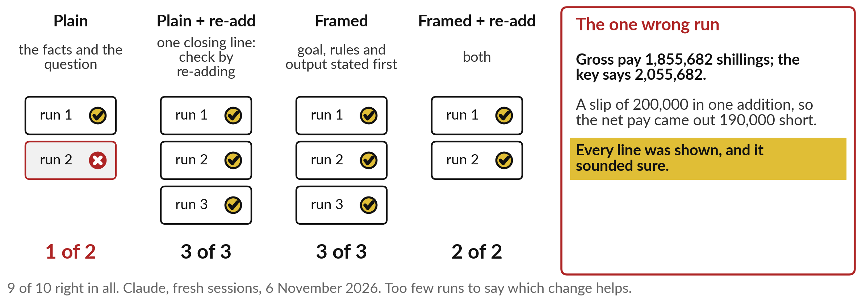
One payroll sum, ten recorded runs: 9 of 10
right, and the wrong one sounded just as sure
Count the runs, and re-add the figure everything else depends on.
Notes:
So I ran one task ten times. It was an invented Nile Valley Foods payroll: salary, overtime, an unpaid day, pension and an advance, with a net pay worked out and checked twice. Four briefs. Plain gave the facts and the question. Framed stated the goal, the rules and the output first.
Re-add means one closing line: check your answer by re-adding the lines. Plain was right once in two runs. The other three were right every time, 8 of 8. In all, 9 of 10. Now look at the wrong run. Its gross pay was 200,000 shillings short through one slip in an addition, so the net pay was 190,000 short, with every line shown in a calm, sure tone.
Ten runs are far too few to say which change helped. The habit is clear: count, and re-add the key figure.

Slide 26
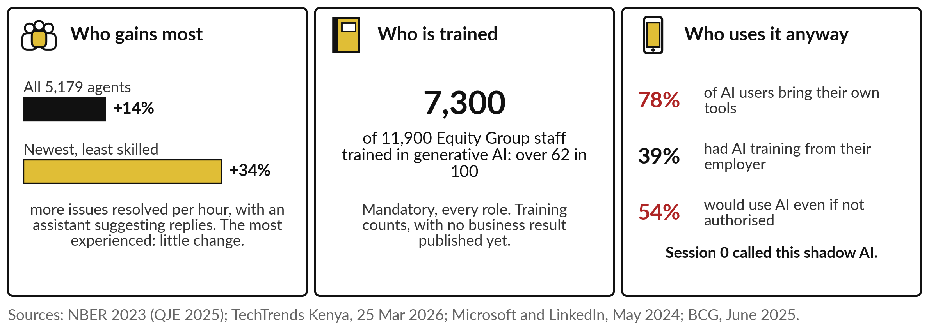
Your people: newer staff gain most, few are
trained, and many use their own tools anyway
The gains are real, uneven and mostly untrained. That is a leader’s job to fix.
Notes:
That habit has to live in your people. Three findings. Who gains most: in a study of 5,179 customer support agents, an assistant suggesting replies raised issues resolved per hour by 14 per cent on average and 34 per cent for the newest and least skilled, with little change for the most experienced.
Procter & Gamble saw the same pattern. Who is trained: Equity Group made generative AI training mandatory for every role, and over 7,300 of its 11,900 staff are trained, though no business result is published yet. Who uses it anyway: Session 0 called this shadow AI, and two surveys count it.
In Microsoft’s, 78 per cent of AI users bring their own tools and only 39 per cent had training from their employer; in BCG’s, 54 per cent would use AI even if not authorised. What does that ask of you?

Slide 27
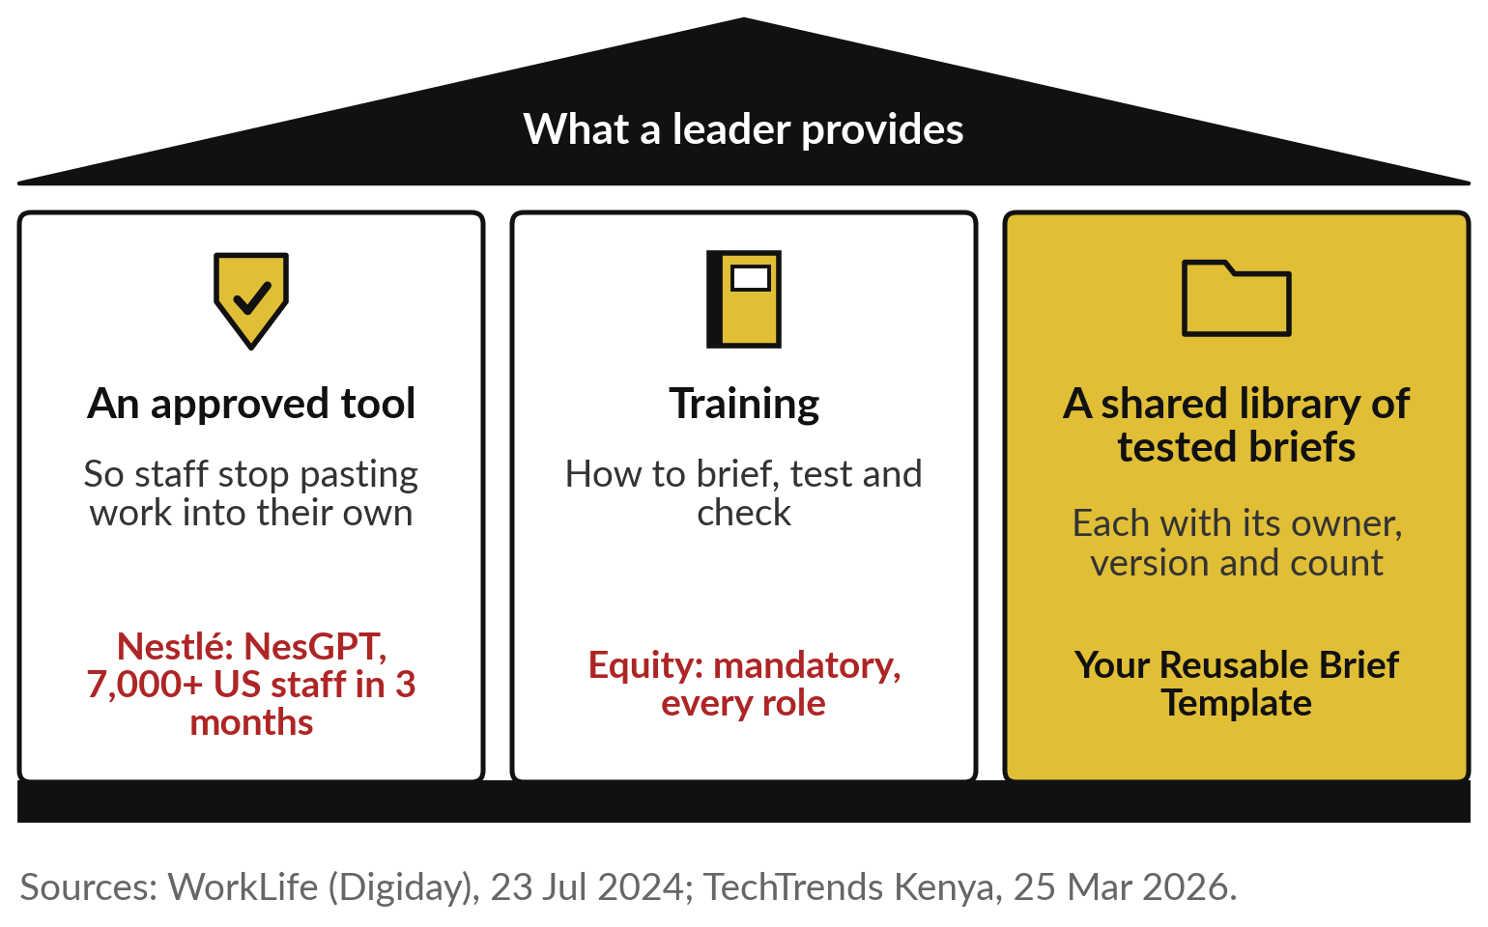
What a leader provides: an approved tool,
training, and a shared library of tested briefs
Make the good habit the easy one.
An approved tool beats a ban.
Train people to brief, test and check.
Share the briefs that pass, with their count.
Notes:
It asks for three things. First, an approved tool, so staff stop pasting company work into their own accounts. Nestlé gave its office staff an internal assistant, NesGPT, and more than 7,000 US employees sent nearly 230,000 prompts in its first three months, with prompt training sessions alongside.
Second, training in how to brief, test and check, for every role, as Equity did. Third, a shared library of tested briefs: each brief with its owner, its version and its count on ten real tasks, so a new joiner starts from the best one your team has.
That library is the Reusable Brief Template, and the counts go in the Reliability Test Record. Before the hands-on, six questions for your team.

Slide 28






Questions to ask your team before an
assistant’s work leaves the building
Ask | Why it matters
Which tasks do we already use assistants for, approved or not? | Shadow use is common; find it first
Which briefs were tested on ten real tasks, and what was the count? | One good reply can be luck
Who checks figures, names and promises before anything is sent? | A wrong run sounds as sure as a right one
Which of our tasks sit outside the frontier? | There, people who trust it do worse
What may never be pasted in? | Customer and staff data follow Uganda’s law
Who keeps the shared brief library up to date? | Models change, and briefs need retesting
Notes:
Everything so far comes down to six questions, one per row. Ask which tasks your team already uses assistants for, approved or not, because shadow use is common. Ask which briefs were tested on ten real tasks and what the count was, because one good reply can be luck.
Ask who checks figures, names and promises before anything is sent, because a wrong run sounds as sure as a right one. Ask which of your tasks sit outside the frontier. Ask what may never be pasted in, because customer and staff data follow the law from Session 6.
And ask who keeps the brief library up to date, because models change and briefs need retesting. Now you write one.

Slide 29
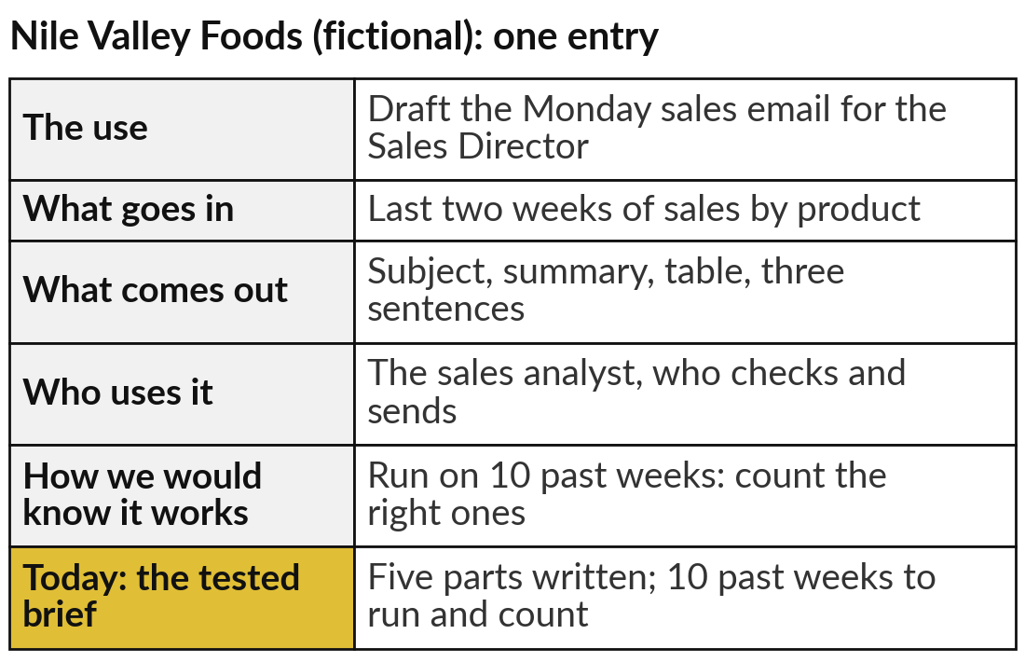
Write a five-part brief for one team
task, and plan its test on ten past cases
25 minutes
Hands-on: your portfolio
Choose a task your team does every week, and brief it.
Write the five parts: role, context, examples, format, constraints.
Read it aloud as the new colleague: what would you still guess?
List ten past cases whose right answer you know.
Name who checks, and add the entry.
You keep: One portfolio entry with its tested-brief plan, in the Reusable Brief Template.
Notes:
For twenty-five minutes you work on your own team, and I walk round. Choose a task your team does every week: a report, a reply to customers, minutes, a summary for the board. Write its brief in the Reusable Brief Template with the five parts. Then read it aloud as if you were the new colleague on day one.
What would you still have to guess?
Fix that. Next, list ten past cases whose right answer you already know; that is your test, and the count goes in the Reliability Test Record when you run it this week. Finally, name who checks the output, and add the task to your AI Opportunity Portfolio. The example on the right is the Monday sales email at Nile Valley Foods, our fictional distributor.

Slide 30




Which team task would you hand to
an assistant first, with a tested brief?
Of the tasks your team does every week, which would you brief and test first?
Drafting
Summary
Sorting
Not yet
Reports, replies and minutes a person checks
Long documents or meetings, for a busy reader
Labelling messages or requests to our examples
Our tasks need facts or sums we cannot check quickly
Write your decision and the reason in your workbook.
Notes:
With your brief written, one decision. Which task would you start with?
Drafting, if a person can check the draft quickly before it goes out. Summary, if your readers are drowning in long documents or meetings. Sorting, if your team labels messages or requests and you can give two good examples. Or not yet, if the task depends on facts or sums nobody can check quickly, or sits outside the frontier.
That is a sound answer, and your first step becomes finding a task that can be checked. Remember the payroll run that was 200,000 shillings out and sounded sure. Tell me your task, your count target out of ten, and who checks.

Slide 31
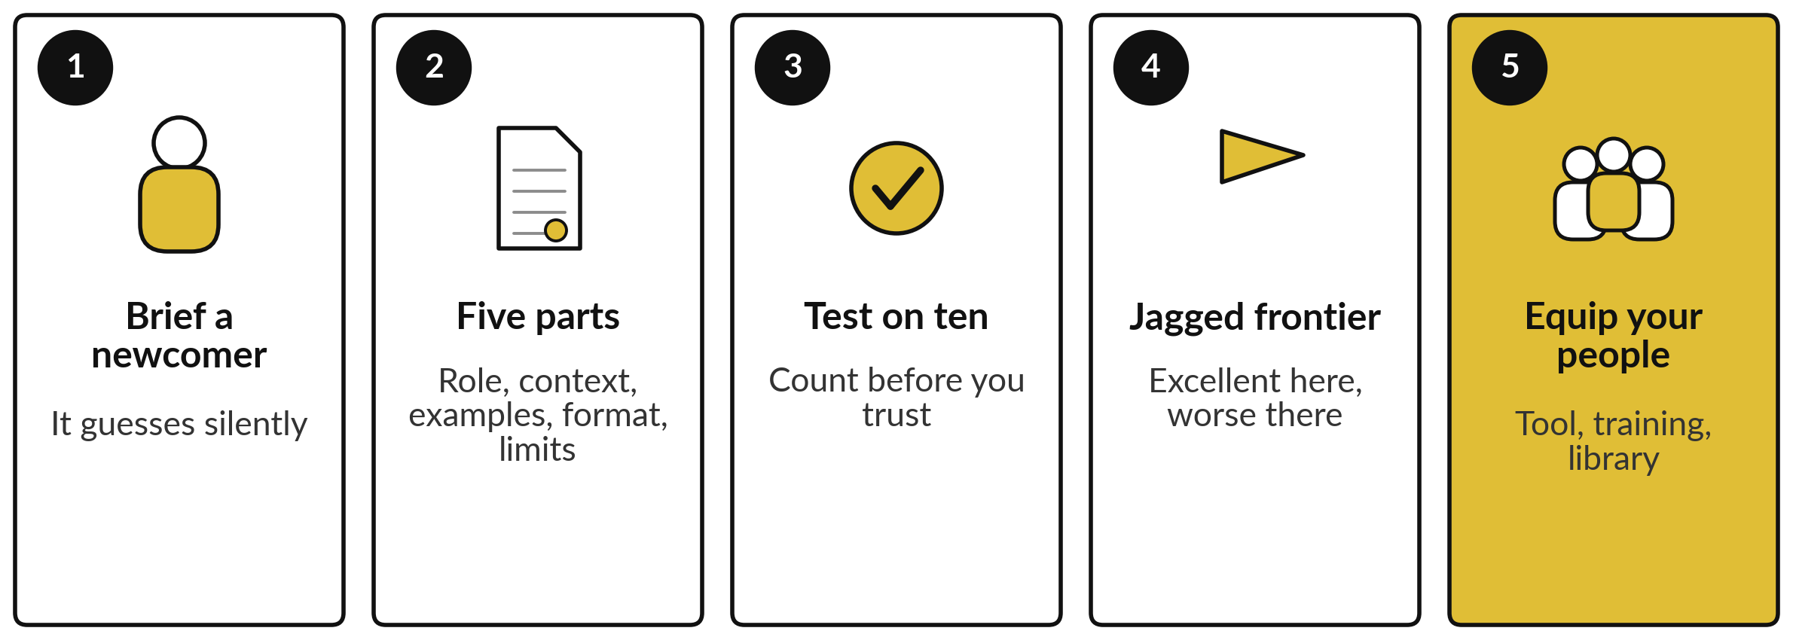
Take-away: five things to remember
Notes:
Here is the session in five lines. Brief the assistant like a capable newcomer, because it never asks; it guesses silently and sounds sure. Use the five parts: role, context, examples, format and constraints, each of which changed a recorded reply today. Test a brief on ten real tasks and count before anyone relies on it; our payroll sum was right 9 times in 10.
Remember the jagged frontier: excellent on some tasks, worse than your staff on others that look alike. And equip your people with an approved tool, training, and a shared library of tested briefs. Now, what you take away.

Slide 32
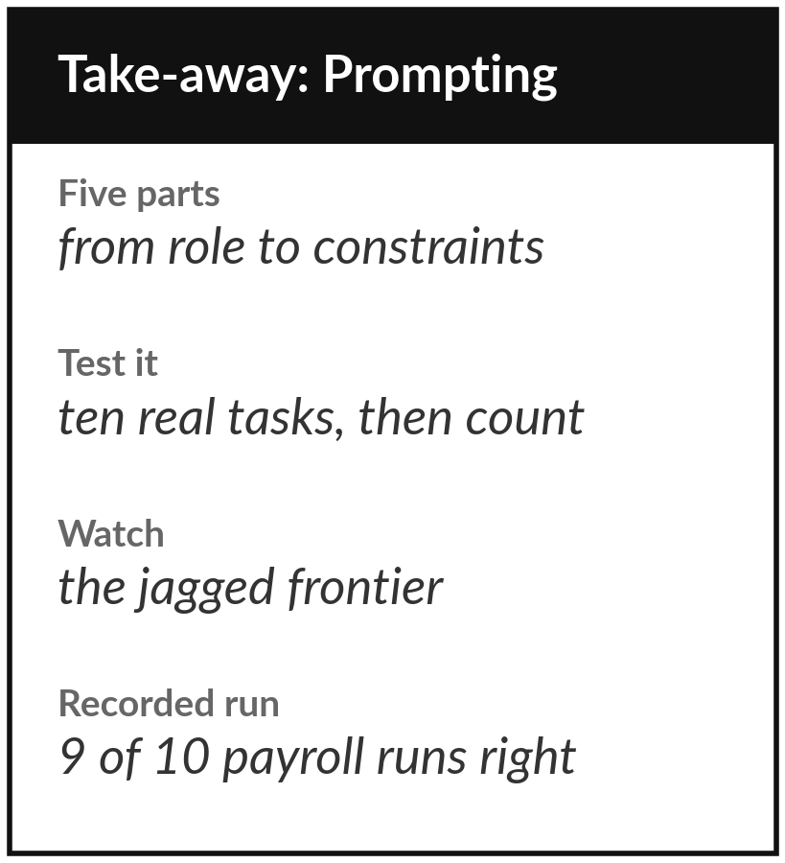
Keep the sheet, and the
tested brief for your team task
What you keep from today
A one-page sheet: the five parts of a brief, the test on ten tasks, the jagged frontier, today’s recorded runs, and your team task with its brief, kept in the Reusable Brief Template and the Reliability Test Record.
Our question today
How do my staff get reliable work from these tools?
Next session
Session 8: Making AI know your business: assistants on your own documents.
Notes:
Keep the take-away sheet. It has the five parts, the test on ten tasks, the jagged frontier, and today’s recorded runs: each part changed the reply, both briefs got the figures right while only the strong one kept to them, and the payroll sum was right 9 times in 10, with the wrong run sounding just as sure.
Your brief goes into the Reusable Brief Template and its count into the Reliability Test Record. In Session 8 we give the assistant your own documents to answer from.
We began with this question: How do my staff get reliable work from these tools? Before you go, say in one sentence what you can now say about it.

